Slide 1
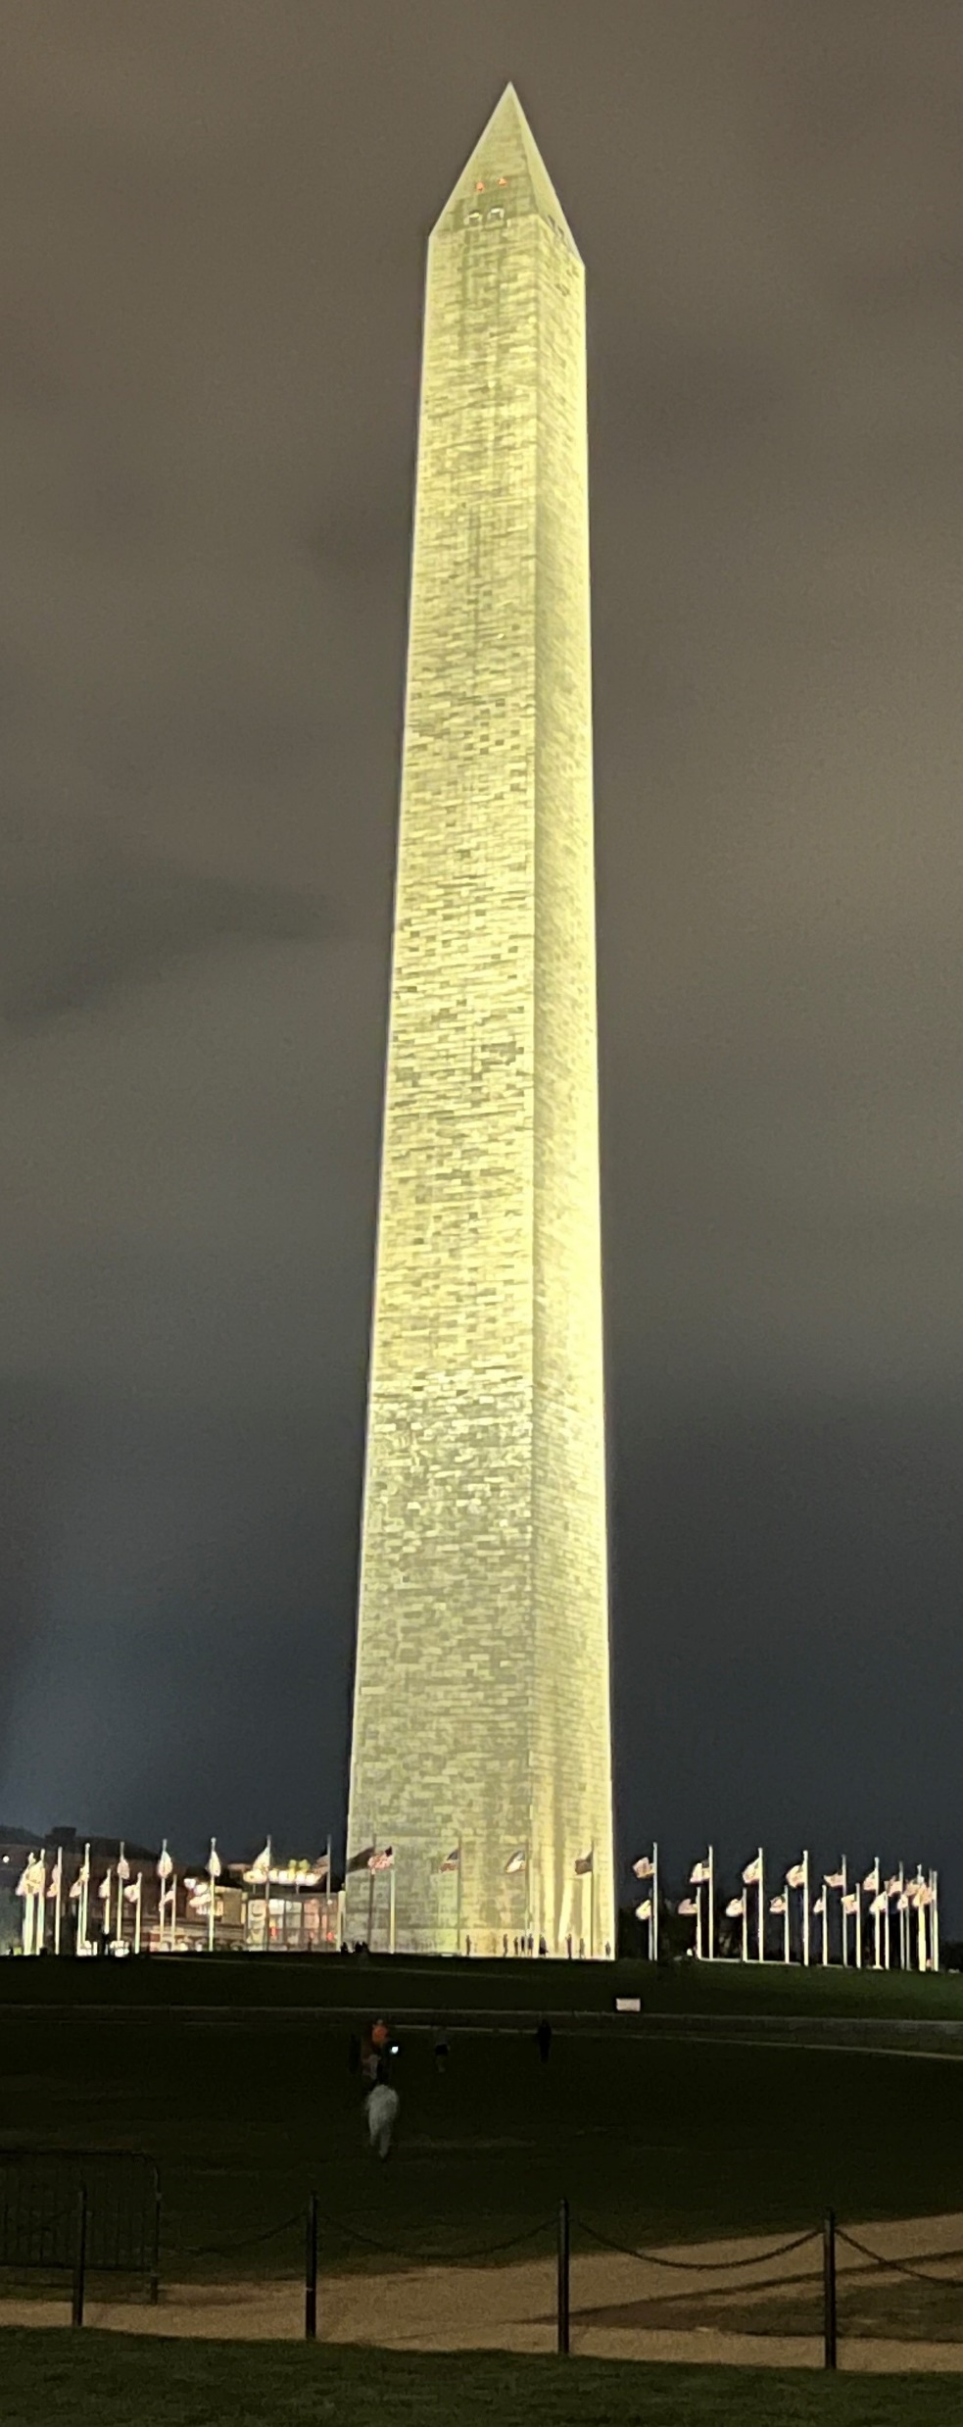
Update
Timothy Bax
Board of Governors
Spokane, Washington
Kristen Kolberg
Resident
Swedish Medical Center

Slide 2
Leadership

Slide 3
Leadership
Your personal mission statement
The role of leadership in times of challenge
Strategies to get what you deserve
Understanding surgeon burnout – institutional solutions
Effective performance-based teaching
The equity imperative of graduate medical education
Executive director update

Slide 4
Leadership
Your personal mission statement
Kimberly Lumpkin
Pediatric Surgeon, University of Maryland

Slide 5
Leadership
Your personal mission statement
Kimberly Lumpkin
Pediatric Surgeon, University of Maryland
Develop a professional mission statement
Identify your skills
Identify your passions
If an activity or leadership opportunity does not meet those criteria it is just generating CV clutter.

Slide 6
Leadership
Effective performance-based teaching
Max Langham, Jr
University of Tennessee

Slide 7
Leadership
Effective performance-based teaching
Max Langham, Jr
University of Tennessee
Approaches resident teaching similarly to pilot teaching
Add teaching debrief to the end of the case
“What did I do well?”
“What can I do better?”
“How can I do that better?”
Educational time out
“What do you want to learn?”

Slide 8
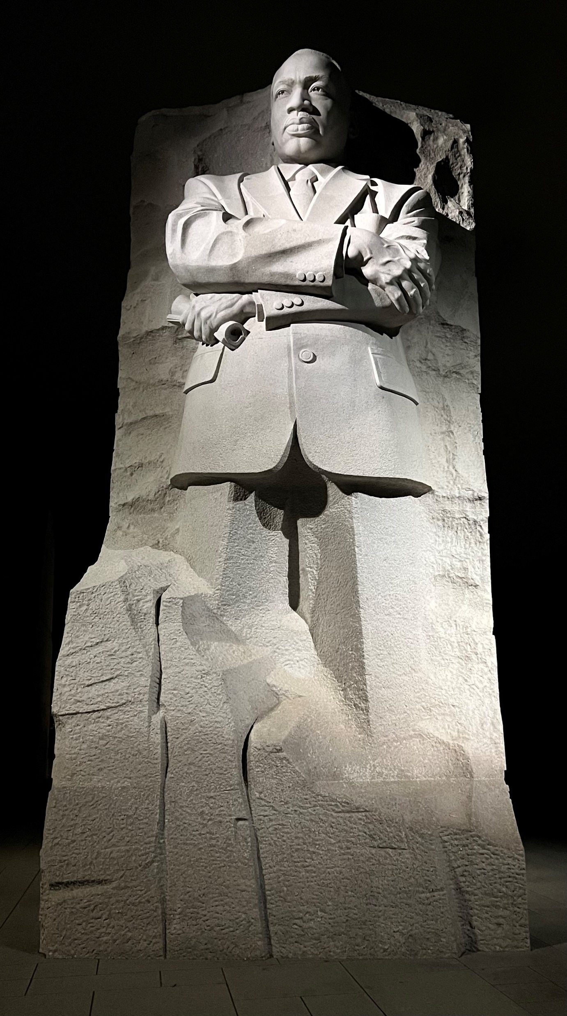
Advocacy

Slide 9
Advocacy
Resident and Young fellows breakfast meetings
The value of a surgeon
Conversation with CMS about updates in quality
Health care equity and surgery
Inside politics and policy experts
ACS, AMA, AHA – opportunities for collaboration

Slide 10
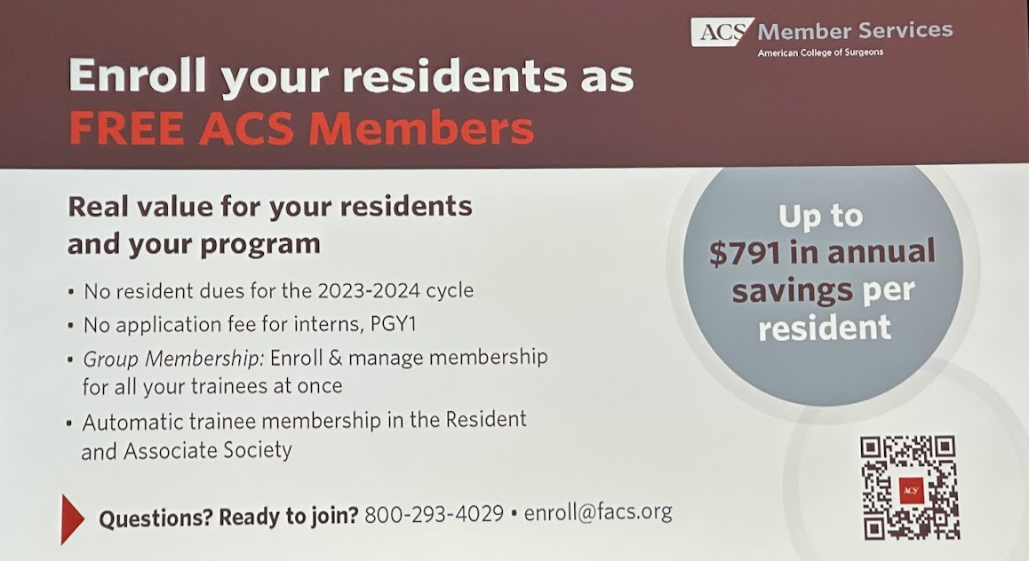
Advocacy
Resident and Young fellows breakfast meeting:
Dues this year for residents are free for the national chapter!
All residents are encouraged to join any of the 5 RAS-ACS committees:
Advocacy and Issues Committee
Membership Committee
Education Committee
Communications Committee
Associate Fellow Committee

Slide 11
Advocacy
Next year's meeting April 13-16, 2024
Abstract Competition!

Slide 12
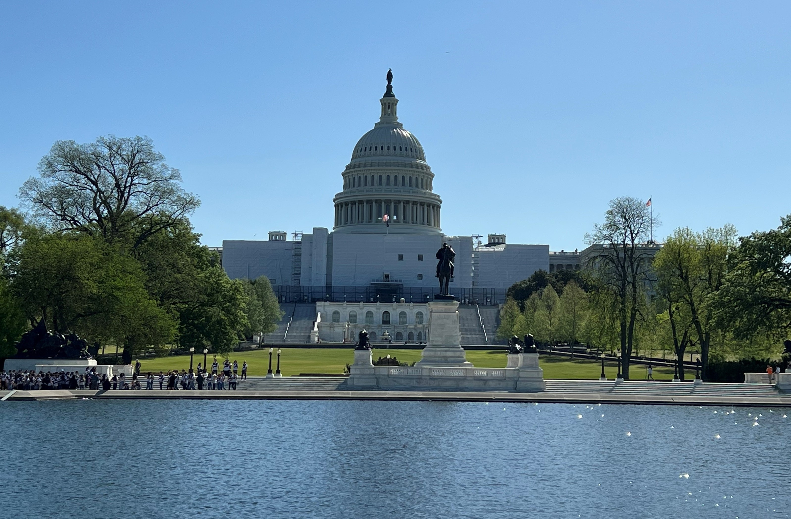
Legislative agenda

Slide 13
Legislative agenda
New legislation
Stop cuts to Medicare physician payments
Workforce Mobility Act banning non-compete clauses
Ensuring Access to General Surgery Act
Resident Education Deferred Interest Act
Specialty Physicians Advancing Rural Care Act
Establish a National Trauma and Emergency Preparedness System (NTEPS)
Prevent Bleeding Act

Slide 14
Legislative agenda
Ongoing funding
Cancer - $63B ($55B)
Firearm injury prevention – $60M ($25M)
Mission Zero - $11.5M ($4M)
New funding
National healthcare workforce commission $3M

Slide 15
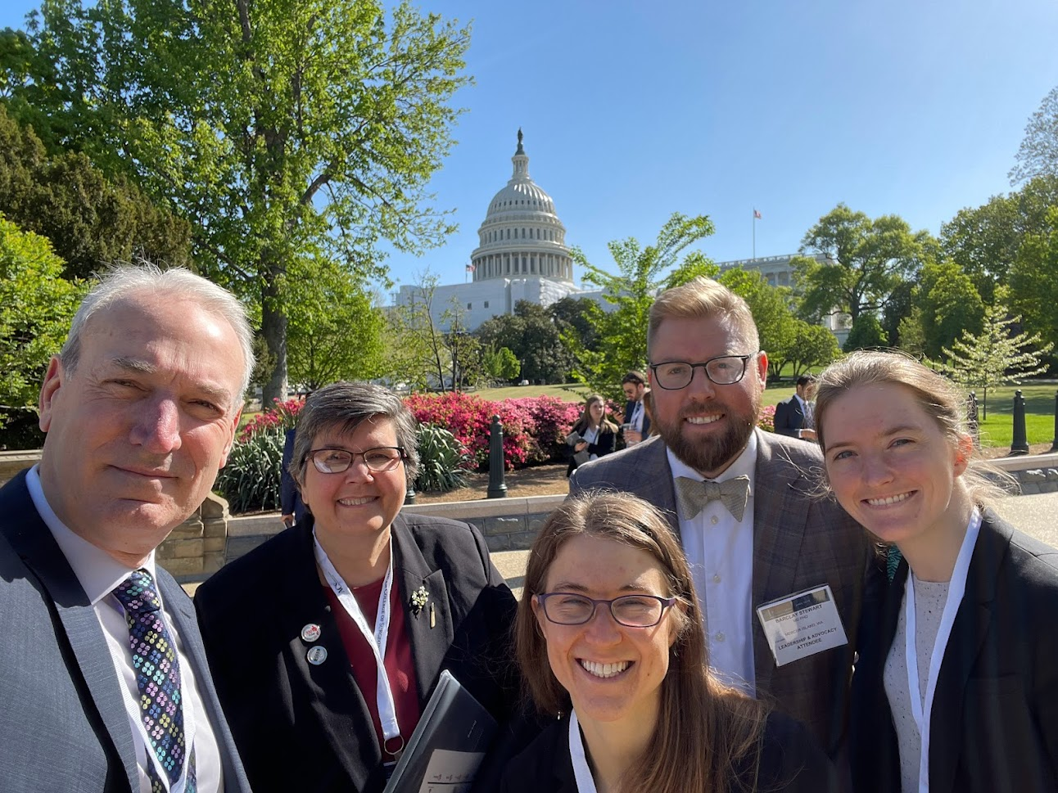
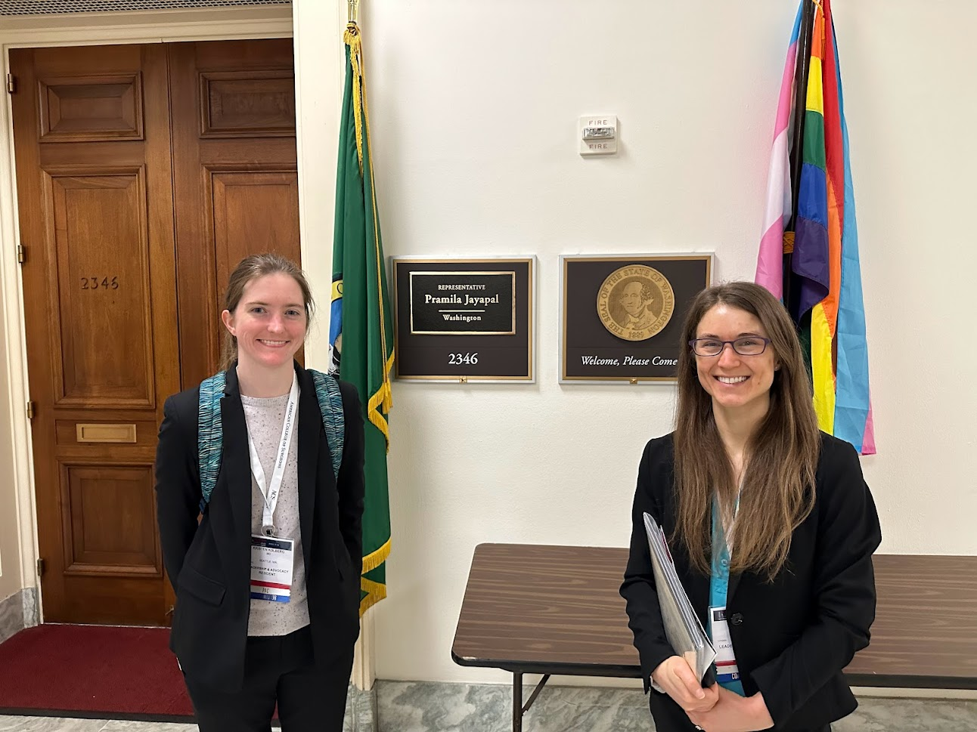
Legislative agenda

Slide 16
Questions??

